Slide 1

Bank Marketing
Sudarshan Kumar
Sunil Mathur
Amanda Morley
Drew McKnight
Sally Cao

Slide 2
Team Page
Discuss content with professor.

Slide 3







The AI Canvas
What task/decision are you examining?
The task being analyzed is determine whether or not a customer will subscribe to a term deposit using a marketing campaign data set targeted to existing customers from a Portuguese banking institution
Prediction
Judgment
Action
Outcome
Predict whether an existing customer would subscribe to a term Deposit Product based on a phone Marketing campaign.
Look at the Customer demographics and previous campaign data and determine the following payoff from the prediction.
Right - the bank will have a customer enrolled into the term deposit with another product from bank
Wrong – customer does not want the deposit and/or move to new company after annoyed with reaching out about campaign
Provide a campaign that fits the customers needs with the bank.
Customer opens or declines a Deposit account with the Bank
Determine the subscribed acceptance rate of the campaign
Training
Input
Feedback
Historical marketing campaign data matched with the historical outcome data. This data is used to train and calibrate the AI model before it is deployed
Historical banking data on existing customers to get a better understanding on which ones to target for campaign
Historical data from similar marketing campaigns in the past is compared with the outcome of the current campaign.
The feedback is then incorporated to update the model, improving the AI
How will this AI impact on the overall workflow?
Will give Bank the opportunity to understand Customer preferences based of the feedback received from the calls in the campaign and determine if any new or better product is better suited for the particular Customer demographics.
© Agrawal, Gans, Goldfarb 2019

Slide 4
EDA & Preprocessing
EDA | Preprocessing
Dataset Info : 45211 rows and 17 columns, No missing values Key features of Data Age: Range 18-95, Mean 41. Age between 18-30 and > 60 have more money to open a deposit account. Average Balance: Range 8k-102k, Mean 1.3K. Higher average balance customer is more likely to open a deposit account. Job - People in management / technical jobs versus students / entrepreneurs / self-employed may have more money to open a deposit account. Marital status - Singles may have more money versus married with family responsibilities. Contact - Cellular seems to be resulting in higher conversion rates Duration : Highly correlated with target variable. However, it is unknown till the end of the call. Education : People with higher education are likely to be high earners and may have enough spare cash to open a deposit account. Credit Default : people with credit default may not be the best candidates to open a deposit account. | Preprocessing is performed using pipeline. Split numerical and categorical data. Used Simple Imputer and Standard Scalar and PCA for numerical data Used Simple Imputer and one hot encoding for Categorical data.

Slide 5
Model training, tuning & selection
Model | Tunning | Score
Decision tree |  | 0.9022616677726166
Random Forest | Gini, entropy | 0.9064919265649193
SVC |  | 0.8987502764875027
Xgboost (In progress) | Best parameters: {'model__max_depth': 2, 'model__n_estimators': 100, 'pca__n_components': 20} | 0.857387
Logistic regression (In progress)
Model Selection:- “Random Forest” with Best Score “90.65%” is selected as the final model.

Slide 6
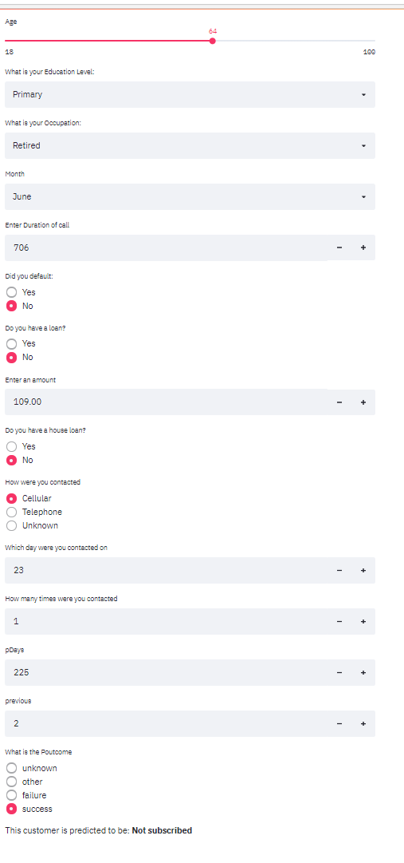
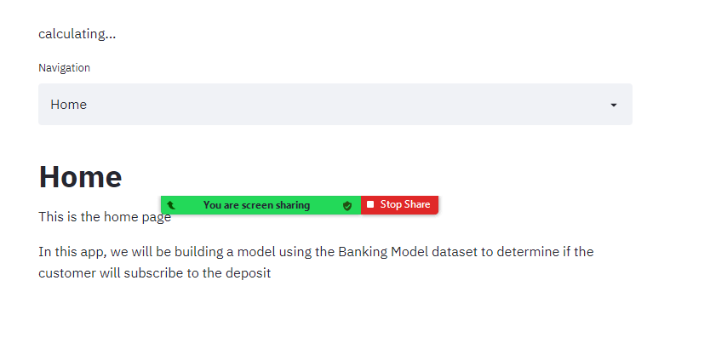
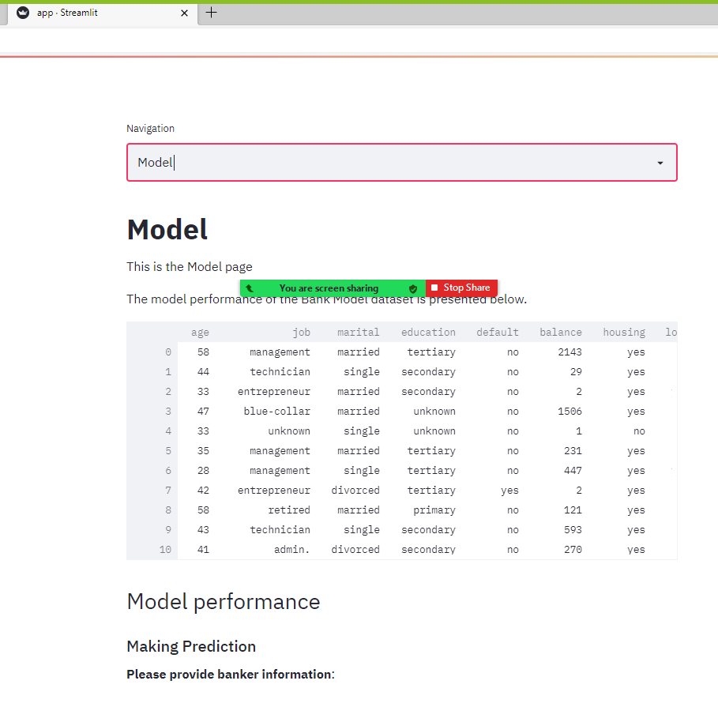
ML Web App Demo

